Slide 1

Introduction
Employee Management System helps to manage the details of the employees of an organisation in a systematic way.
Data management software have helped in making the organizations work easily and efficiently.

Slide 2

Objectives
The aim of this project is to simplify the task of maintaining records of the employees of a company.
To design a well-designed database to store employee information.
To provide a comprehensive approach towards the management of employee information.
To provide full functional reports to the management of company.

Slide 3
Methodology of Proposed System
The project is divided into 2 sections to make the programme easy to understand.
The first part receives user name and password to log in and register.
The second part is used to keep the record of employee salary, his department of working, his performance in the office.
It also adds a new employee, increments salary, shows list of employees and their details.

Slide 4

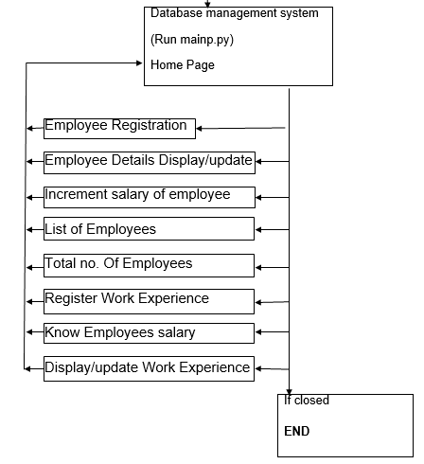
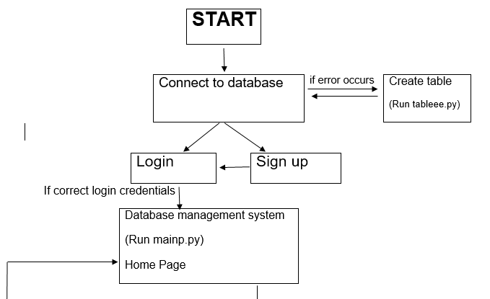
Flowchart
A

Slide 5
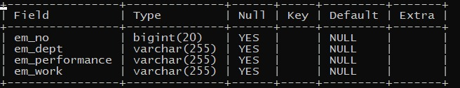

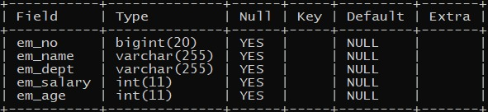
Tables Created in DBMS
em_performance
log_id
office

Slide 6
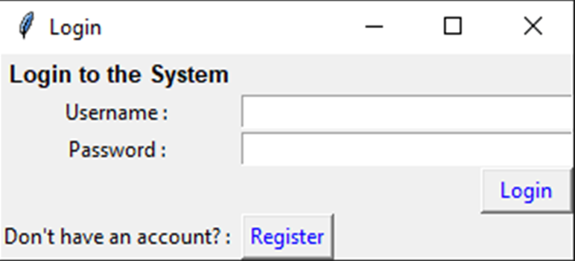
Login Window
The Login tab is the first interface that the user faces in this program.
It links the python program to the database in MySQL and creates database if not found.

Slide 7
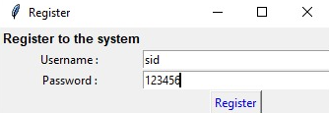
Register
If the user is not logged in to the program, he/she can register himself/herself using this tab.

Slide 8
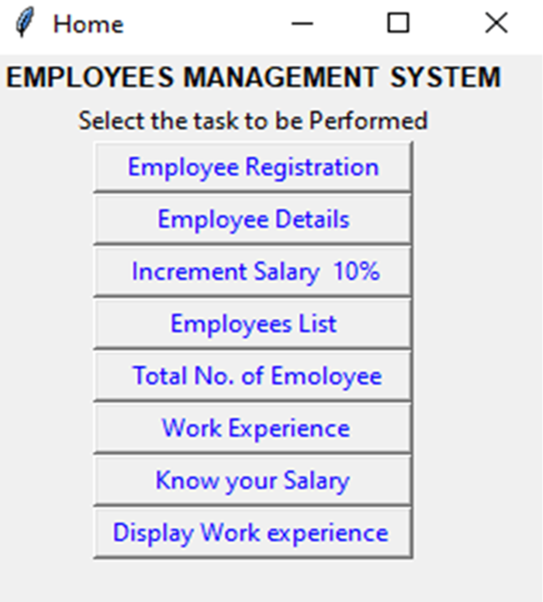
Home tab
The Home tab helps the user to navigate through the different features of the program.
Each of the buttons in the Home tab are explained in the following slides.

Slide 9
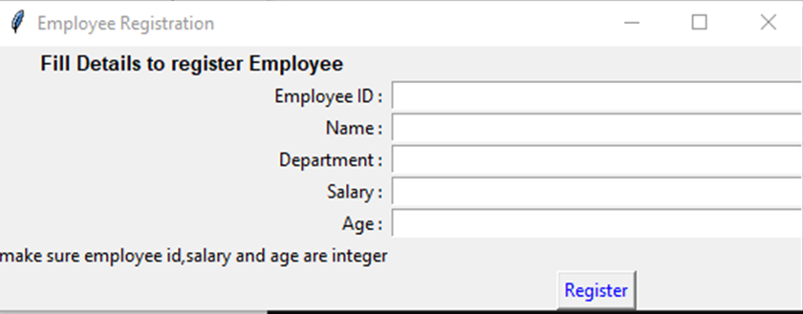
Employee Registration
The Employee registration tab takes the details of the employees as input and saves them in the MySQL database.
The Register button redirects the user to the Home tab.

Slide 10
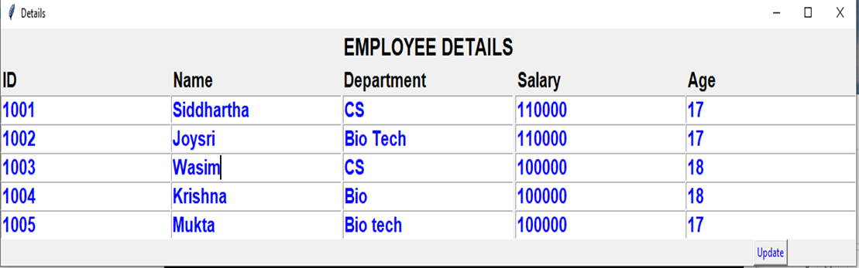
Employee Details
The employee Details tab displays all the details of the employees.
The details of the employees can also be changed using this tab.

Slide 11
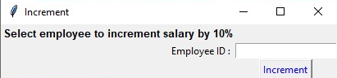
Increment Salary 10%
This tab increases the salary of a specified employee by 10%.

Slide 12
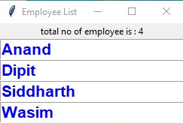
Employees List
This tab shows the names of all the employees present in the organisation.

Slide 13
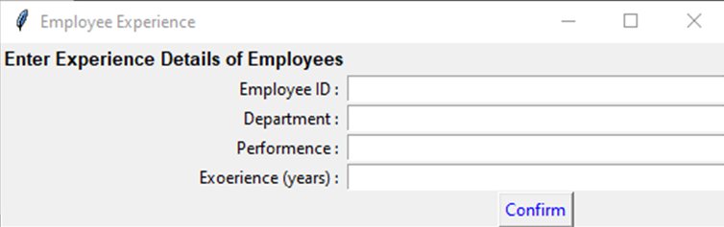
Work Experience
This tab takes the input from the user about the work experience of the employees and saves it in the database.
The confirm button redirects the user to the Home tab.

Slide 14
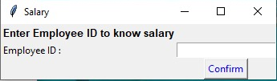
Know Your Salary
This tab displays the salary of the specified employee.
The confirm button redirects the user to the Home tab.

Slide 15
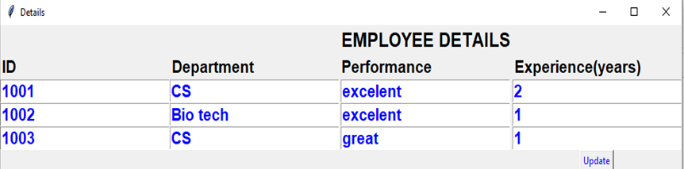
Display Work Experience
This tab displays the work experience of all the employees.
Work Experience details of the employees can also be updated using the update button.
The update button redirects the user to the Home tab.

Slide 16
THANK YOU!!!

